Slide 1
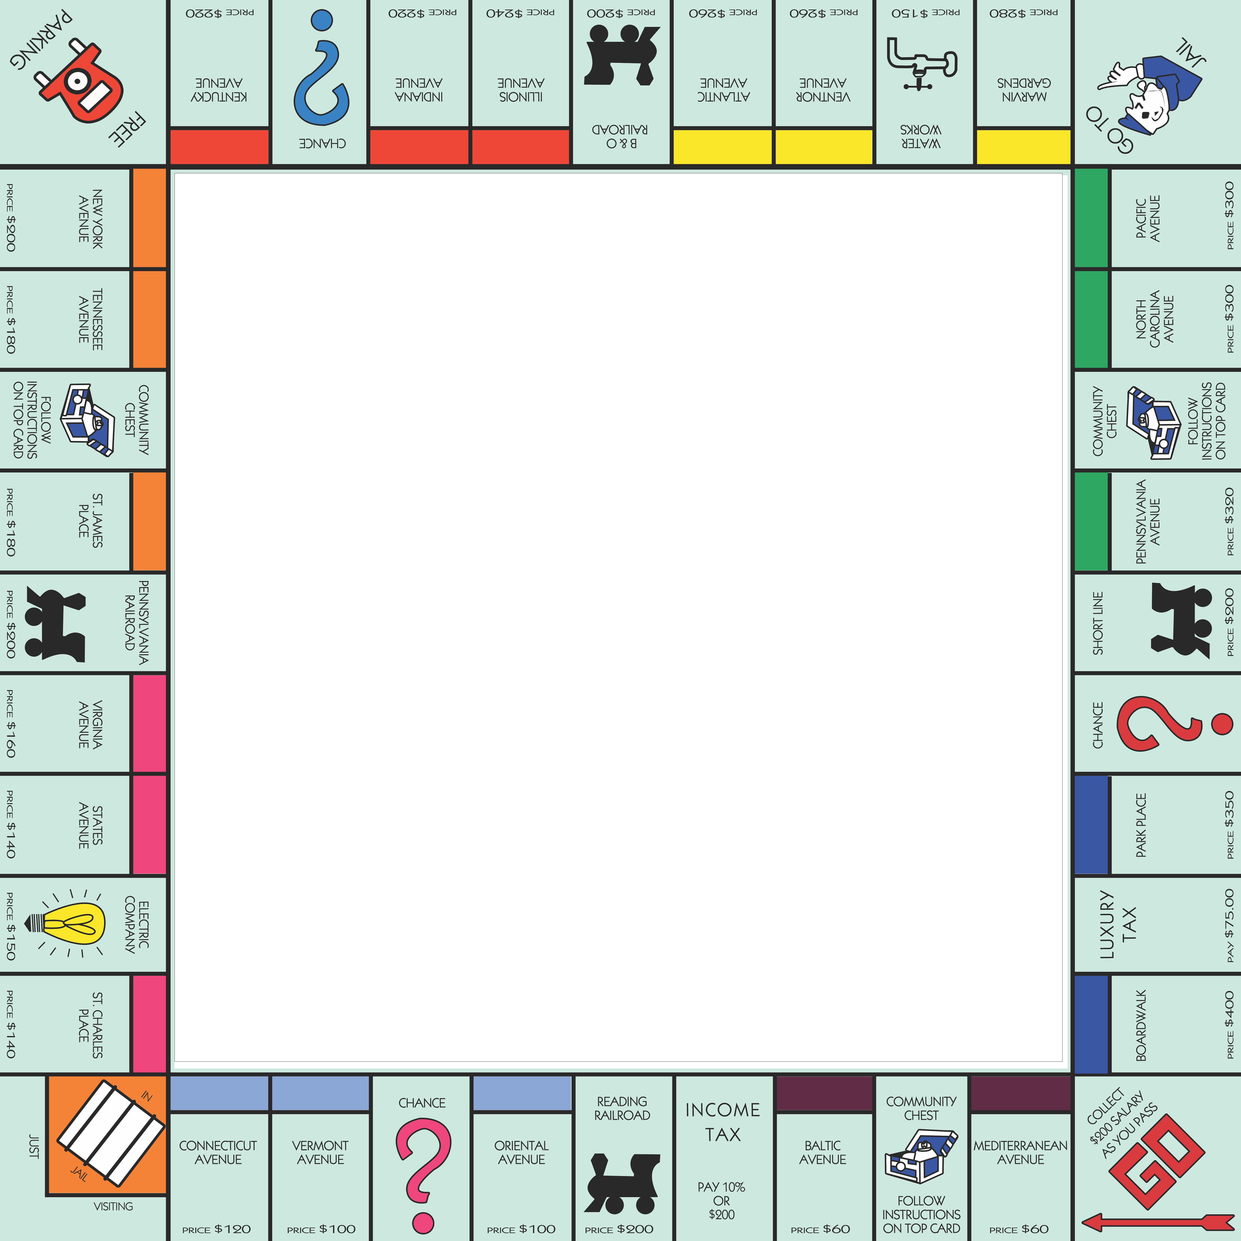
Markov Chains in the Game of Monopoly
Linear Algebra and Matrix Analysis
Taylor Marx, Nathan Jensen, John Navarro,
Gordon Dri, John Balcarcel

Slide 2
Table of Contents
1 | Problem Description
2 | Introduction to Markov Chains
3 | Execution and Code Development
4 | Simulation
5 | Conclusions

Slide 3
Problem Description

Slide 4
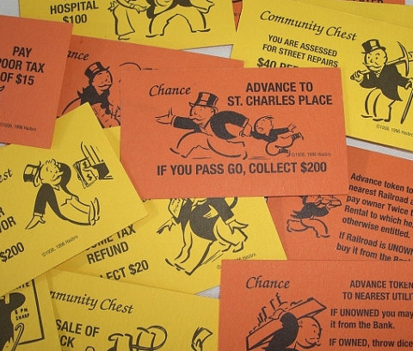


Monopoly the Game
How to play Monopoly
Objective is to force your competition into bankruptcy and own the Monopoly

Slide 5
Problem Description
The problem statement
A strategy for monopoly must provide the player with advice on making the choices that arise in the game, such as:
Which properties are worth purchasing?
Which properties to develop houses/hotels first?
Which properties should I sell or trade to other players?
Just as in real-world real estate transactions the costs of investments must be weighed against the prospective returns
The prognosis of returns can be made only on the basis of probabilities and expectations
Our Approach
Develop a finite state Markov process to determine the probability that an opponent will land on a given property and leverage these probabilities to calculate expected rent for each property

Slide 6
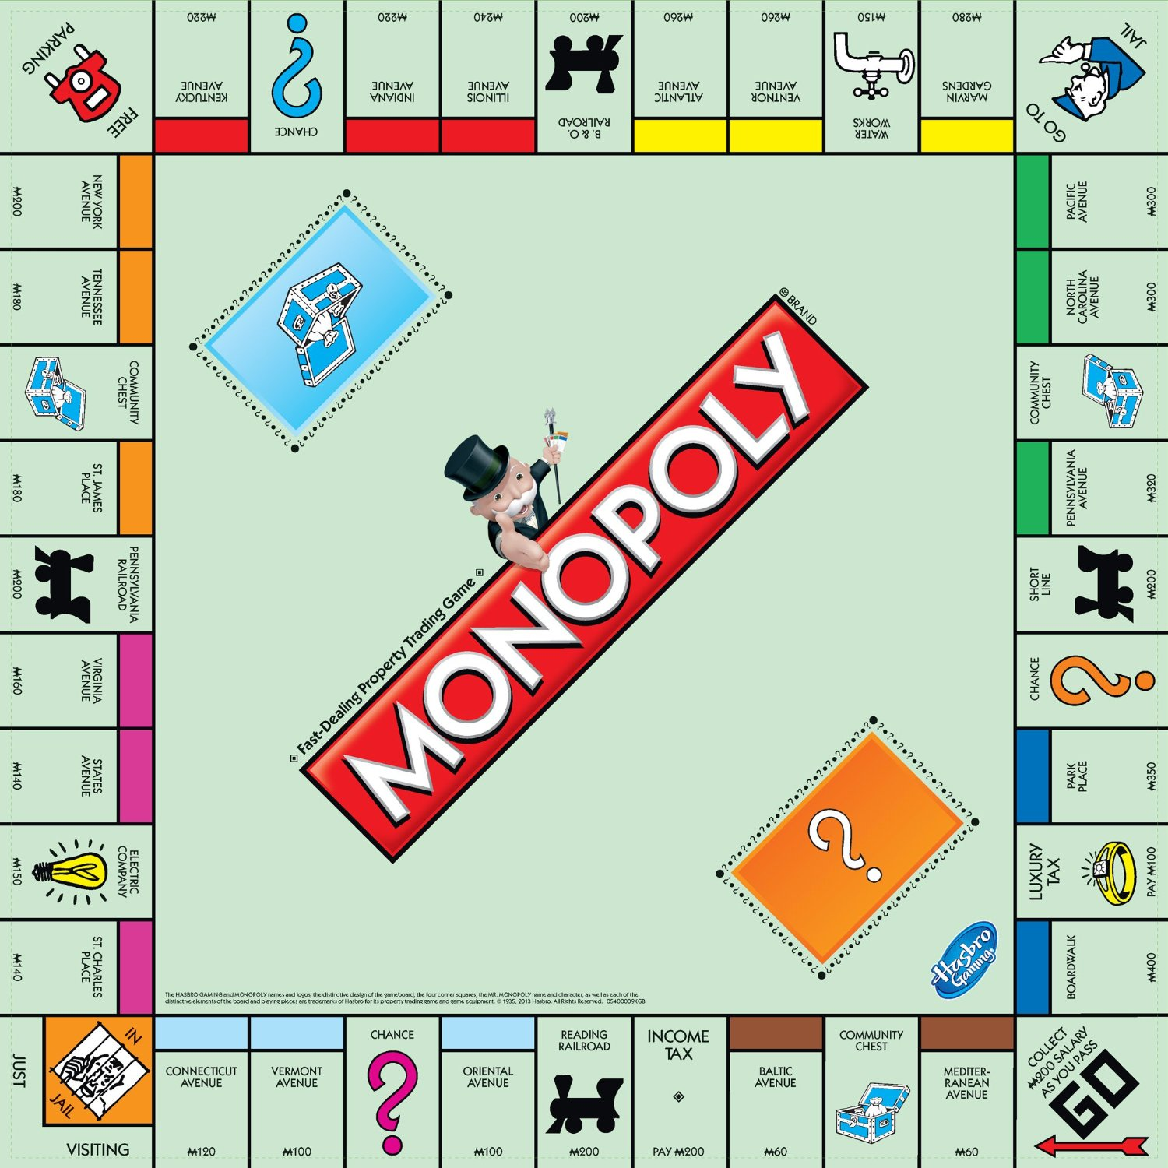
Most Valuable Properties

Slide 7
Introduction to Markov Chains

Slide 8
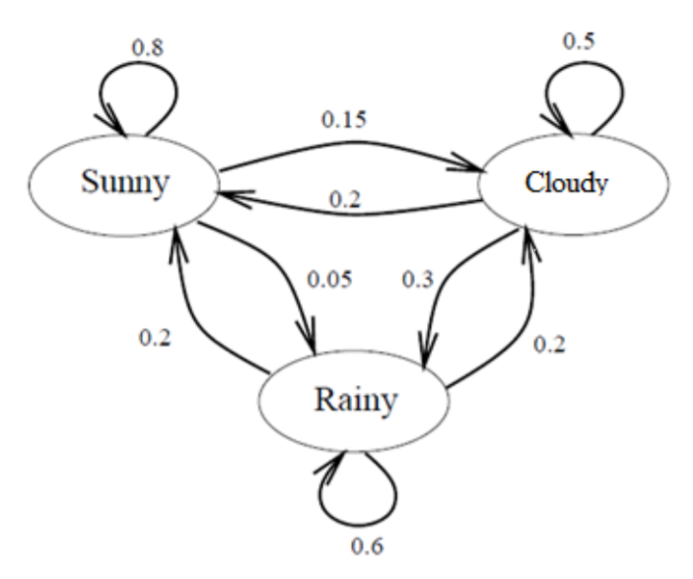
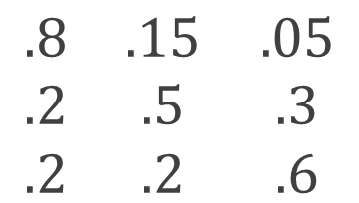
Markov Chain: Overview / Assumptions
Example Markov Model for Weather Prediction
Representative Transition Matrix (T)
End State
Sunny
Cloudy
Rainy
Sunny
$$\begin{matrix}.8 & .15 & .05 \\ .2 & .5 & .3 \\ .2 & .2 & .6\end{matrix}$$
Begin State
Cloudy
--
State
Rainy
Transition Probability
Markov Model Assumptions
Markov Property: Probability that an event occurs on the (n+1)th trial depends only on the nth trial
Sojourn in a State: A finite number of states whose changes take place at fixed intervals in random fashion
Transition probabilities: Each state’s probabilities must sum to 1

Slide 9











Markov Chain: Predicting Future States
Future states of the system can be found under the general equation:
$${x_{n}=x}_{n−1} ∗T$$
Example: If today is cloudy, what will be the weather the day after tomorrow?
Transition Matrix (T)
Initial State X0
$$\begin{matrix}.8 & .15 & .05 \\ .2 & .5 & .3 \\ .2 & .2 & .6\end{matrix}$$
State X1
Step 1: Find the weather for tomorrow (𝑥₁), by multiplying today’s weather (𝑥₀), by the transition matrix (T)
$$\begin{matrix}0 & 1 & 0\end{matrix}$$
$$\begin{matrix}.2 & .5 & .3\end{matrix}$$
$$x_{1}=x_{0} ∗T=$$
$$=$$
Transition Matrix (T)
Probability of sunny, cloudy, or rainy on day 2
Step 2: Repeat step 1 to find the weather for the day after tomorrow
State X1
$$\begin{matrix}.8 & .15 & .05 \\ .2 & .5 & .3 \\ .2 & .2 & .6\end{matrix}$$
$$\begin{matrix}.2 & .5 & .3\end{matrix}$$
$$\begin{matrix}.32 & .34 & .32\end{matrix}$$
$$x_{2}=x_{1} ∗T=$$
$$=$$

Slide 10



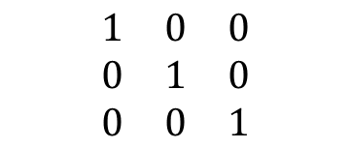


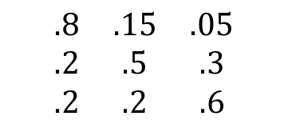


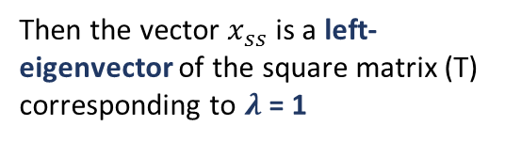

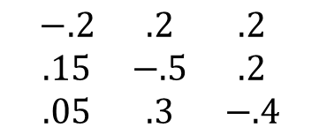

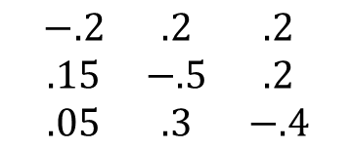

Markov Chain: Steady State Distributions
What is the state of the system as n as approaches infinity (i.e., the steady state distribution)?
1
Unknown steady state vector 𝑥_{𝑠𝑠}
Solve with Null space
Transition Matrix (T)
Identity Matrix (I)
$x_{ss}∗T=$ $x_{ss}$
$$\begin{matrix}.8 & .15 & .05 \\ .2 & .5 & .3 \\ .2 & .2 & .6\end{matrix}$$
$$\begin{matrix}1 & 0 & 0 \\ 0 & 1 & 0 \\ 0 & 0 & 1\end{matrix}$$
$$\begin{matrix}x \\ y \\ z\end{matrix}$$
$x_{ss}∗T−x_{ss}=$ 0
$x_{ss}∗(T−I)=$ 0
$$\begin{matrix}−.2 & .2 & .2 \\ .15 & −.5 & .2 \\ .05 & .3 & −.4\end{matrix}$$
$$\begin{matrix}x \\ y \\ z\end{matrix}$$
$$\begin{matrix}0 \\ 0 \\ 0\end{matrix}$$
Solving for the null space (Ax=0) gives the steady state distribution
$$\begin{matrix}.5 \\ .25 \\ 25\end{matrix}$$
${\left(T−I\right)}^{T}∗x_{ss}=$ 0
$$=$$
2
If a vector remains unchanged when multiplied by a square matrix:
Solve with Eigenvectors
To find the eigenvectors, we solve the general equation:
$$\left(T − λ I\right)x=0$$
$x_{ss}∗T=$ $λ$ ${∗ x}_{ss}$
$$\begin{matrix}−.2 & .2 & .2 \\ .15 & −.5 & .2 \\ .05 & .3 & −.4\end{matrix}$$
$$\begin{matrix}x \\ y \\ z\end{matrix}$$
$$\begin{matrix}0 \\ 0 \\ 0\end{matrix}$$
$$\begin{matrix}.5 \\ .25 \\ 25\end{matrix}$$
Then the vector $x_{ss}$ is a left-eigenvector of the square matrix (T) corresponding to $λ$ = 1
$$=$$

Slide 11
Treating Monopoly as a Markov Process
Markov Model Assumptions
Monopoly Transition Matrix
Discrete Markov States: The 40 properties on the Monopoly board along with 2 jail states will each become a “Markov State”
Markov Property: Each dice roll is independent and outcome is related only to current position
Transition probabilities: The sum of the “END” probabilities for each property will sum to 1
Steady State: Eigenvalue of the transition matrix (see right) is equal to one, which confirms a steady state exists
 | Go | Mediter. Avenue | Community Chest |  |  | Park Place | Luxury Tax | Boardwalk
Go | 0 | 0 | 1/36 |  |  | 0 | 0 | 0
Mediterranean Avenue | 0 | 0 | 0 |  |  | 0 | 0 | 0
Community Chest | 0 | 0 | 0 |  |  | 0 | 0 | 0
Park Place | 1/18 | 1/12 | 1/9 |  |  | 0 | 0 | 1/36
Luxury Tax | 1/36 | 1/18 | 1/12 |  |  | 0 | 0 | 0
Boardwalk | 0 | 1/36 | 1/18 |  |  | 0 | 0 | 0
. . .
. . .
. . .
. . .
. . .
. . .
. . .
. . .
. . .
. . .
. . .
. . .
Treating the board as a Markov Model allows us efficiently find the long-term probability distribution through linear algebra methods

Slide 12
Code Development and Execution

Slide 13
Simulation

Slide 14
Monopoly Simulation
Empirically proving the steady state through probability
Perform manual multiplications of the transition matrix to get to the steady state
“Dumb method”, turn by turn
Will show probability distribution vectors at the 1st, 2nd, 3rd & 15th state
How many iterations (or dice rolls) to get to the steady state?
Proves the effectiveness of Markov Chains

Slide 15
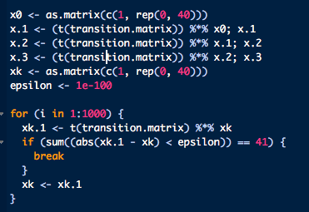
# of Iterations to Steady State
Epsilon = 1e-100
427 iterations to get to Steady State
x₁ = M_{xo}
x₂ = M_{x1}
x₂ = M(M_{xo)}
x₂ = M²_{xo}
x_{k} = M^{k}_{xo}
x₄₂₇ = M⁴²⁷_{xo}

Slide 16
Turn #1, #2, #3, & #15 Probabilities
Multiply the transition matrix by the probability distribution vector at state 0 to obtain the probability distribution vector at state 1 (i.e. 1 turn later)
Continue multiplying by the probability vector to get to vector state 2, vector state 3, and vector state 15.

Slide 17
Steady State Vector & Probabilities
Perform programmatic multiplications of the transition matrix by the probability distribution vectors at states 1, 2, 3 and until the steady state (i.e state i)
Set i = 1,000 iterations
Epsilon = 1e-100
Steady State distribution:
Between 2% - 3%
Peak after Jail

Slide 18
Conclusions

Slide 19
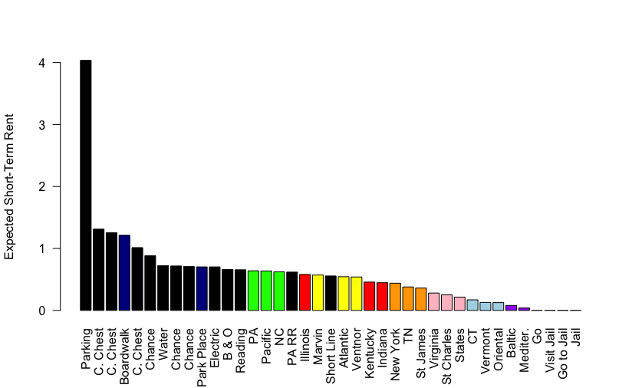
Undeveloped Rank of Spaces
Strategy
Probabilities never outweigh hotel rents
Non-hotel spaces relatively more valuable
Expected rent negligible
Illinois is the only property that jumps a group

Slide 20
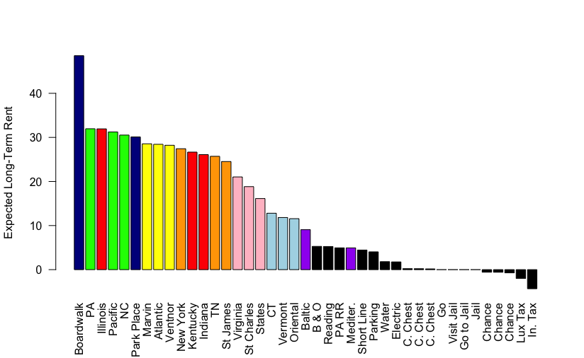
Developed Rank of Spaces
Strategy
Probabilities never outweigh hotel rents
Avoid any pre-Jail spaces (light blue and purple), rail roads, and utilities
Pay a premium for Boardwalk, Illinois, and New York

Slide 21
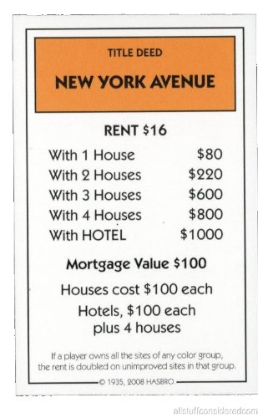
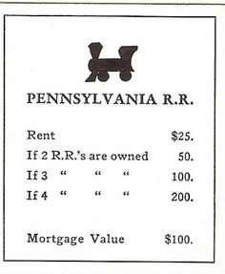
Future Enhancements
Consider costs of properties and compute break-even point
Consider value of completing monopolies to evaluate trades

Slide 22
Questions?

